Slide 1
Think NXT Program
SQL Server Database training – Session2
December 2021

Slide 2
Agenda
Introduction to SQL
SQL Datatypes
SQL Commands
SQL Operators
SQL Clauses
SQL Aggregate Functions
SQL Joins
SQL SET Operators

Slide 3
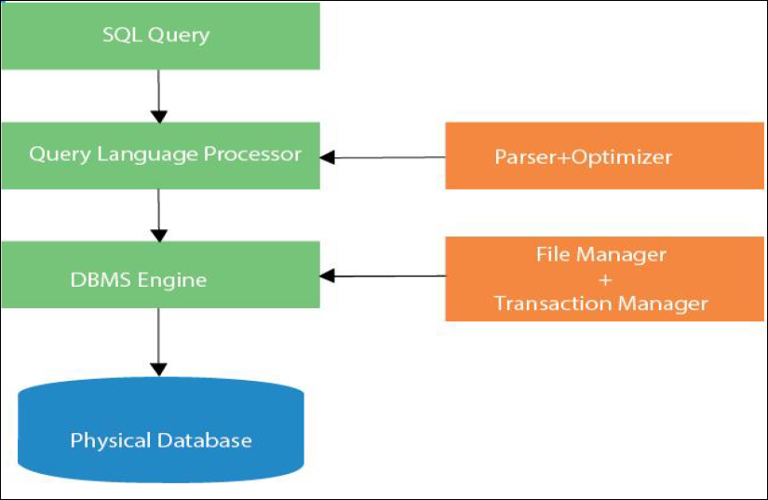
What is SQL
SQL stands for Structured Query Language. It is used for storing and managing data in Relational Database Management System (RDBMS).
It is a standard language for Relational Database System. It enables a user to create, read, update and delete relational databases and tables.
All the RDBMS like MySQL, Informix, Oracle, MS Access and SQL Server use SQL as their standard database language.
SQL allows users to query the database in several ways, using English-like statements.
What is Advantages of SQL?
High speed
No coding needed
Well defined standards
Portability
Interactive language
Multiple data view

Slide 4
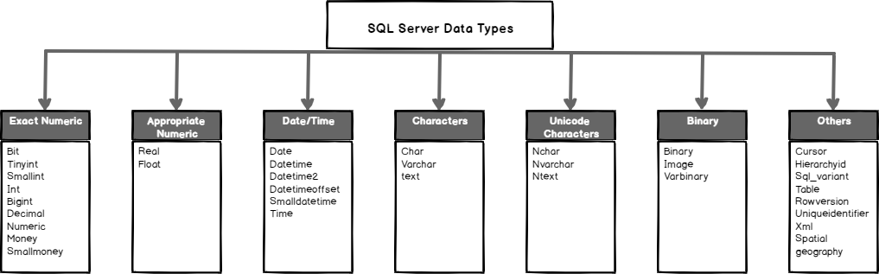
SQL Data Types
SQL Datatype is used to define the values that a column can contain.
Every column is required to have a name and data type in the database table.

Slide 5
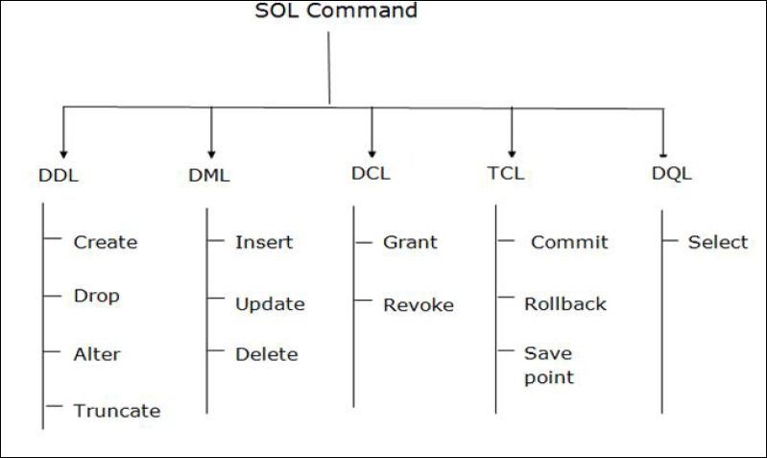
SQL Commands
SQL commands are instructions. It is used to communicate with the database. It is also used to perform specific tasks, functions, and queries of data.
• SQL can perform various tasks like create a table, add data to tables, drop the table, modify the table, set
permission for users.

Slide 6
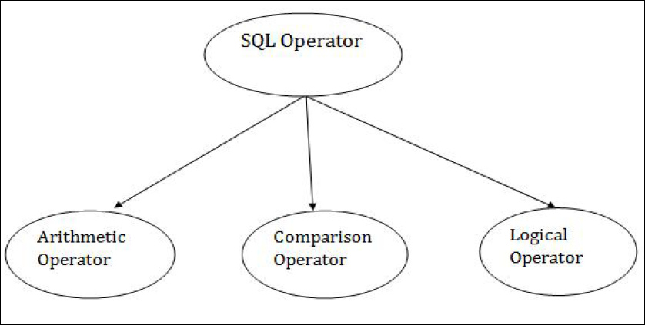
SQL Operators
Arithmetic Operators
Operator | Desc
+ | It adds the value of both operands.
- | It is used to subtract the right-hand operand from the left-hand operand.
* | It is used to multiply the value of both operands.
/ | It is used to divide the left-hand operand by the right-hand operand.
% | It is used to divide the left-hand operand by the right-hand operand and returns reminder.

Slide 7
SQL Operators
Comparison Operators
Operator | Desc
= | It checks if two operands' values are equal or not, if the values are queal then condition becomes true.
!= | It checks if two operands' values are equal or not, if values are not equal, then condition becomes true.
<> | It checks if two operands' values are equal or not, if values are not equal then condition becomes true.
> | It checks if the left operand value is greater than right operand value, if yes then condition becomes true.
< | It checks if the left operand value is less than right operand value, if yes then condition becomes true.
>= | It checks if the left operand value is greater than or equal to the right operand value, if yes then condition becomes true.
<= | It checks if the left operand value is less than or equal to the right operand value, if yes then condition becomes true.
!< | It checks if the left operand value is not less than the right operand value, if yes then condition becomes true.
!> | It checks if the left operand value is not greater than the right operand value, if yes then condition becomes true.

Slide 8
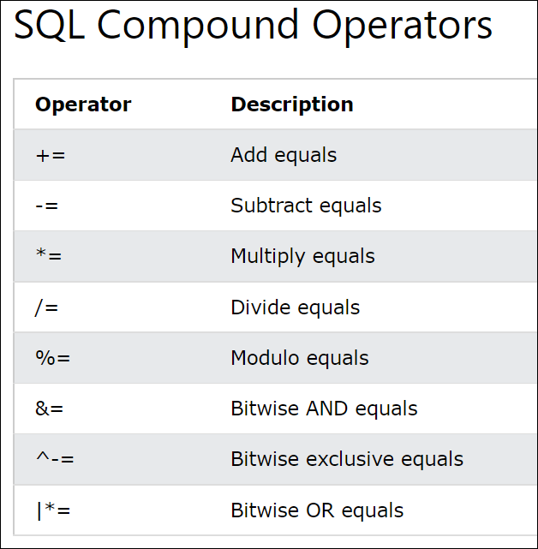
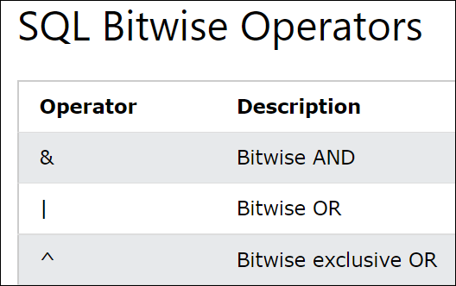
SQL Operators

Slide 9
SQL Operators
Logical Operators
Operator | Desc
All | It compares a value to all values in another value set.
AND | It allows the existence of multiple conditions in an SQL statement.
ANY | It compares the values in the list according to the condition.
Between | It is used to search for values that are within a set of values.
IN | It compares a value to that specified list value.
NOT | It reverses the meaning of any logical operator.
OR | It combines multiple conditions in SQL statements.
EXIST | It is used to search for the presence of a row in a specified table.
LIKE | It compares a value to similar values using wildcard operator.

Slide 10
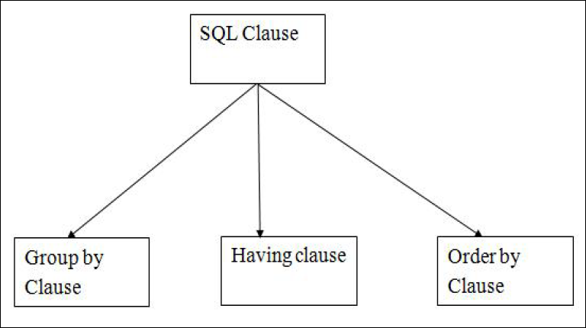
SQL Clauses
GROUP BY statement is used to arrange identical data into groups.
GROUP BY statement is used with the SQL SELECT statement.
GROUP BY statement follows the WHERE clause in a SELECT statement and precedes the ORDER BY clause.
GROUP BY statement is used with aggregation function.
HAVING clause is used to specify a search condition for a
Group or an aggregate.
Having is used in a GROUP BY clause. If you are not using GROUP BY clause then you can use HAVING function like a WHERE clause
ORDER BY clause sorts the result-set in ascending or descending order.
It sorts the records in ascending order by default. DESC keyword is used to sort the records in descending order.

Slide 11
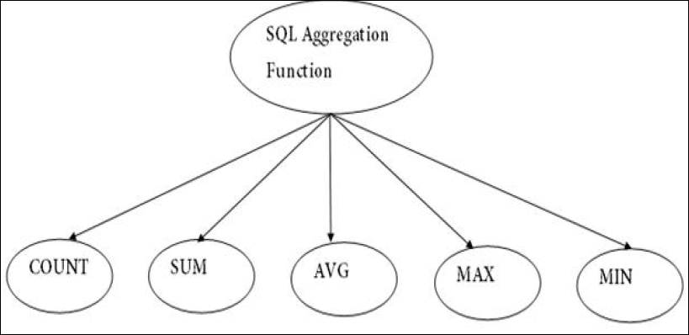
SQL Aggregate Functions
COUNT function is used to Count the number of rows in a database table. It can work on both numeric and non-numeric data types.
COUNT function uses the COUNT(*) that returns the count of all the rows in a specified table. COUNT(*) considers duplicate and Null.
SUM function is used to calculate the sum of all selected columns. It works on numeric fields only.
AVG function is used to calculate the average value of the
numeric type. AVG function returns the average of all non-Null values.
MAX function is used to find the maximum value of a certain column. This function determines the largest value of all selected values of a column.
MIN function is used to find the minimum value of a certain Column. This function determines the smallest value of all selected values of a column

Slide 12
CREATE TABLE
The CREATE TABLE statement is used to create a new table in a database.
CREATE TABLE new_table_name AS SELECT column1, column2,... FROM existing_table_name WHERE ....;

Slide 13
UPDATE Statement
UPDATE table_name SET column1 = value1, column2 = value2, ... WHERE condition;
Insert Statement
INSERT INTO table_name (column1, column2, column3, ...) VALUES (value1, value2, value3, ...);

Slide 14
SELECT
SELECT * FROM table_name;
SELECT column1, column2, ... FROM table_name;
SELECT DISTINCT column1, column2, ... FROM table_name;
SELECT function(column_name) FROM table_name WHERE condition;

Slide 15
Select with TOP / LIMIT
SELECT TOP number|percent column_name(s) FROM table_name WHERE condition;
SELECT column_name(s) FROM table_name WHERE condition LIMIT number;
Keyword | Database System
TOP | SQL Server, MS Access
LIMIT | MySQL, PostgreSQL, SQLite

Slide 16
SELECT with WHERE
SELECT column1, column2, ... FROM table_name WHERE condition1 AND condition2 AND condition3 ...;
SELECT column1, column2, ... FROM table_name WHERE condition1 OR condition2 OR condition3 ...;
SELECT column1, column2, ... FROM table_name WHERE NOT condition;

Slide 17
SELECT with LIKE
LIKE Operator | Description
WHERE CustomerName LIKE 'a%' | Finds any values that starts with "a"
WHERE CustomerName LIKE '%a' | Finds any values that ends with "a"
WHERE CustomerName LIKE '%or%' | Finds any values that have "or" in any position
WHERE CustomerName LIKE '_r%' | Finds any values that have "r" in the second position
WHERE CustomerName LIKE 'a__%' | Finds any values that starts with "a" and are at least 3 characters in length
WHERE ContactName LIKE 'a%o' | Finds any values that starts with "a" and ends with "o"
SELECT column1, column2, ... FROM table_name WHERE columnN LIKE pattern;

Slide 18
SQL IN Syntax
SELECT column_name(s) FROM table_name WHERE column_name IN (value1, value2, ...);
SQL IN Syntax with nested Query
SELECT column_name(s) FROM table_name WHERE column_name IN (SELECT STATEMENT);

Slide 19
BETWEEN Syntax
The BETWEEN operator selects values within a given range. The values can be numbers, text, or dates.
The BETWEEN operator is inclusive: begin and end values are included.
SELECT column_name(s) FROM table_name WHERE column_name BETWEEN value1 AND value2;

Slide 20
ORDER BY Syntax
SELECT column1, column2, ... FROM table_name ORDER BY column1, column2, ... ASC|DESC;

Slide 21
SQL GROUP BY Statement
SELECT column_name(s) FROM table_name WHERE condition GROUP BY column_name(s) ORDER BY column_name(s);
The GROUP BY statement groups rows that have the same values into summary rows, like "find the number of customers in each country".
The GROUP BY statement is often used with aggregate functions (COUNT(), MAX(), MIN(), SUM(), AVG()) to group the result-set by one or more columns.

Slide 22
SQL HAVING Clause
SQL HAVING clause is similar to the WHERE clause.
they are both used to filter rows in a table based on conditions.
However, the HAVING clause was included in SQL to filter grouped rows instead of single rows.
These rows are grouped together by the GROUP BY clause, so, the HAVING clause must always be followed by the GROUP BY clause.
It can be used with aggregate functions, whereas the WHERE clause cannot.
SELECT column_name(s) FROM table_name WHERE condition GROUP BY column_name(s) HAVING condition ORDER BY column_name(s);

Slide 23
SQL Joins
INNER JOIN selects records that have matching values in both tables as
long as the condition is satisfied. It returns the combination of all rows from both the tables where the condition satisfies.
SQL Join
LEFT JOIN returns all the values from left table and the matching values from the right table. If there is no matching join value, it will return NULL.
RIGHT JOIN returns all the values from the values from the rows of right table and the matched values from the left table. If there is no matching in both tables, it will return NULL.
INNER
LEFT
RIGHT
FULL
FULL JOIN is the result of a combination of both left and right outer join.
Join tables have all the records from both tables. It puts NULL on the place
of matches not found.

Slide 24
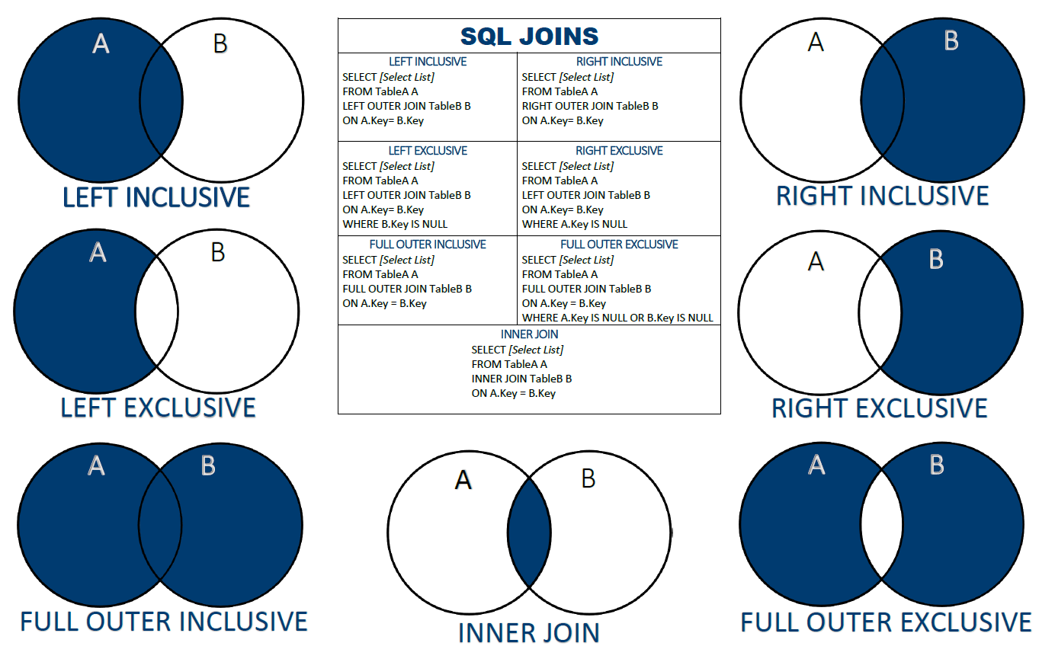

Slide 25
SQL SET Operators
SET Operators
UNION operation is used to combine the result of two or more SQL
SELECT queries.
• In the UNION operation, all the number of datatype and columns must be same in both the tables on which UNION operation is being applied.
• The UNION operation eliminates the duplicate rows from its result set.
UNION
UNION ALL
INTERSECT
MINUS
INTERSECT is used to combine two SELECT statements. The Intersect operation returns the common rows from the SELECT statements.
• In the Intersect operation, the number of datatype and columns must be the same.
• It has no duplicates, and it arranges the data in ascending order by default.
MINUS combines the result of two SELECT statements. Minus operator is used to
display the rows which are present in the first query but absent in the second query.
• It has no duplicates and data arranged in ascending order by default.

Slide 26
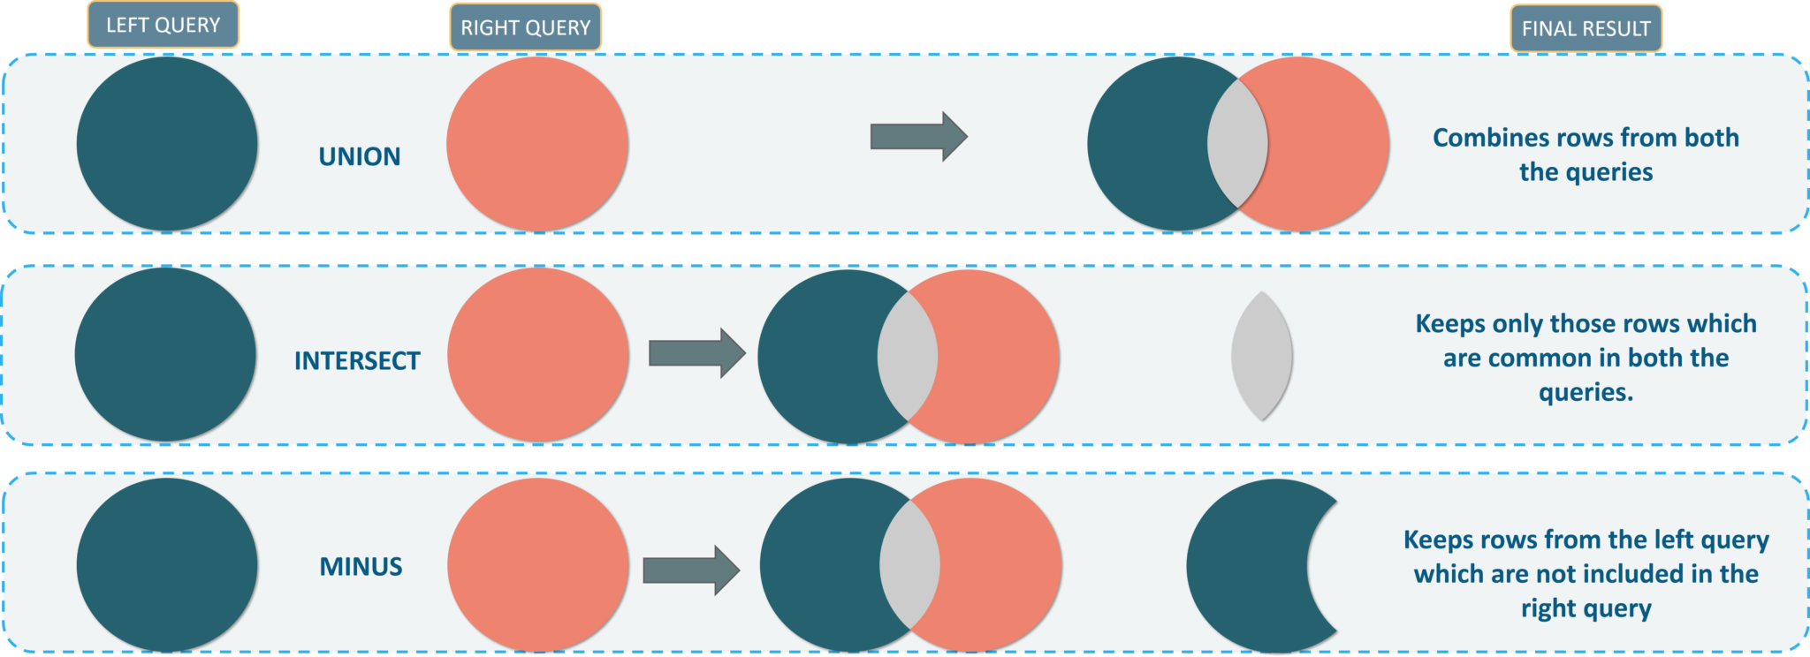

Slide 27
SQL GROUP BY Statement
SELECT column_name(s) FROM table1 UNION SELECT column_name(s) FROM table2;

